Slide 1
ECEN 5623 Real-Time Embedded Systems Team #13 Ayswariya Kannan, Kiran Jojare
Real-time Stop Sign Detection For Vehicles

Slide 2

Presentation Roadmap
Introduction
System Block Diagram
Capability Requirements
Real Time Requirements
Performance Requirements - WCET
Service Set Feasibility and Safety Analysis
System Response Timeline Diagram
Flowchart & DFD
Proof-of-Concept Analysis
Verification & Validation Plans
Summary

Slide 3
Introduction
The primary objective is to prototype a real-time embedded system that serves as a sign detection bot, which will be able to detect and respond to STOP signs, enhancing safety and situational awareness in intelligent transportation systems.
Using the OpenCV library and the camera module on the Jetson Nano, we employ image processing techniques to detect traffic signs by leveraging Haar Cascade classifiers.
We are leveraging the FreeRTOS kernel on the TIVA C123GX for efficient multitasking and prioritization maintaining real-time requirements.

Slide 4
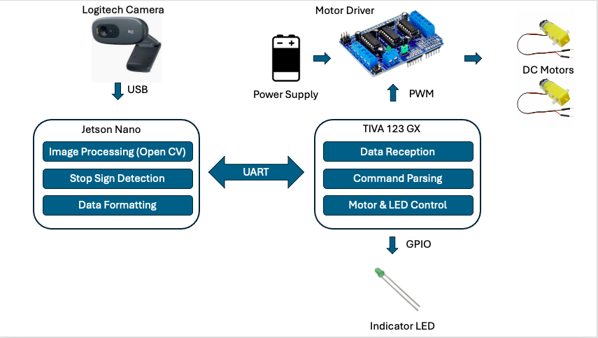
System Block Diagram
6V

Slide 5
Capability Requirements
High-Performance Traffic Sign Detection: The camera interfaced with an NVIDIA Jetson Nano for detecting STOP signs, operating at 640 x 480 resolution, optimizing image quality and computational demand.
Reliable and Fast Data Communication: The NVIDIA Jetson Nano reliably communicates processed traffic sign data to the TIVA C123G microcontroller using UART at a baud rate of 115200 bps.
Precise and Responsive Motor Actuation: Initiating motor actuation within 10 msec of receiving the command is crucial to ensure the vehicle's safe and efficient response to STOP sign.
Status Indication through LED Notification: The LED should illuminate within 250 msec of traffic sign detection and motor action execution, providing prompt diagnostics feedback to the vehicle operator.

Slide 6

Real-Time Requirements
For traffic sign detection to work, we need the braking system to activate performing better than the human reaction time, as per the research paper the average brake reaction for males is 0.50 seconds and for females is 0.53 seconds. Thus, we have kept the total system response timeline as 500 msec.
As per the research done, we have the deadline for the camera service task as 200 msec.
According to the research paper, we have a deadline for the motor control task for the right and left motor as 10 msec.
LED service is a lower-priority task with a deadline of 250 msec.

Slide 7
Real-Time Requirements Contd..
We have four services:
S1: Camera Data Reception from Jetson Nano
S2: Right Motor Control
S3: Left Motor Control
S4: Diagnostic LED Control
We have taken period same as the deadline for the Rate monotonic scheduling policy, shown in the table below.
D1+D2+D3+D4 = 470 msec < 500 msec (system response deadline)
Services | Task | Deadline(ms) | Time period(ms) | Priority(ms)
S1 | Camera Data Reception from Jetson Nano | 200 | 200 | 2 (Medium)
S2 | Right Motor Control | 10 | 10 | 1 (Highest)
S3 | Left Motor Control | 10 | 10 | 1 ((Highest))
S4 | LED Control | 250 | 250 | 3 (Lowest)

Slide 8
Performance Requirements
According to the research paper referred, the WCET for camera service is 327 msec considering the Quad-core ARM® Cortex®-A57 MPCore processor
Motor control service has a WCET requirement of 3 msec according to the research paper
Utilizing the clock frequency of the TIVA board (80 MHz), GPIO pins can be configured with a reduced instruction set and may require up to 2 milliseconds to complete. WCET requirement for LED control service = 2 msec

Slide 9
Service Set Feasibility and Safety Analysis
WCET: Expected Ci vs Actual
TIVA services have almost similar WCET values to predicted
For Service S1: WCET is 69 msec performed better than expected
For Service S2 &S3: WCET actual is 3 msec matching the predicted values.
For Service S4: It is 1 msec better than the predicted.
Services | Task | WCET Expected (ms) | WCET Actual (ms) | Deadline(ms) | Time period(ms) | Priority(ms)
S1 | Camera Data Reception from Jetson Nano | 327 | 69 | 200 | 200 | 2 (Medium)
S2 | Right Motor Control | 3 | 3 | 10 | 10 | 1 (Highest)
S3 | Left Motor Control | 3 | 3 | 10 | 10 | 1 ((Highest))
S4 | LED Control | 2 | 1 | 250 | 250 | 3 (Lowest)

Slide 10
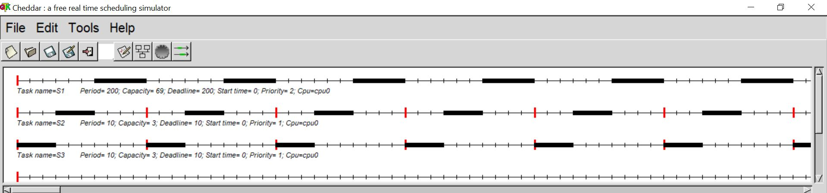
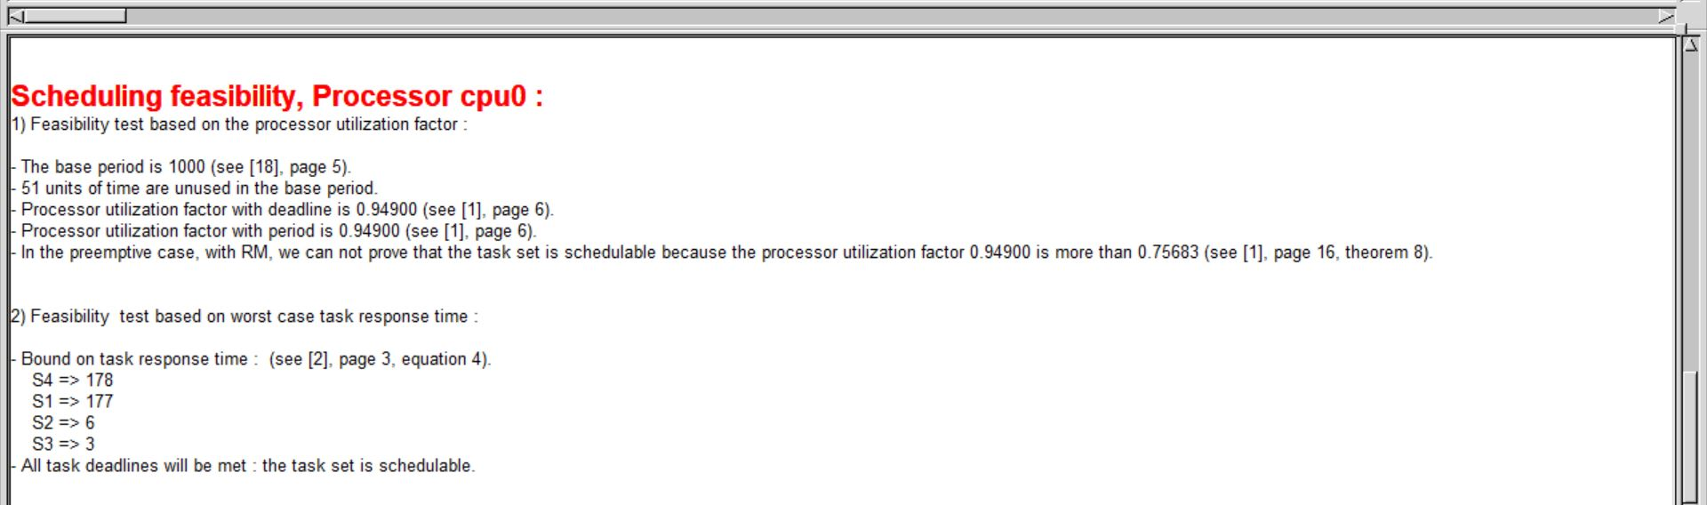
Cheddar Analysis for Worst-Case and Simulation
According to Cheddar Analysis , Total utilization with the actual WCET= 94.9%
We can’t prove feasibility with RM LUB Test as it is above RM LUB 75.683%.
Based on Necessary & Sufficient test, it can be seen task set is schedulable
Safety Margin is 5.1%
Safety : No deadline missed

Slide 11
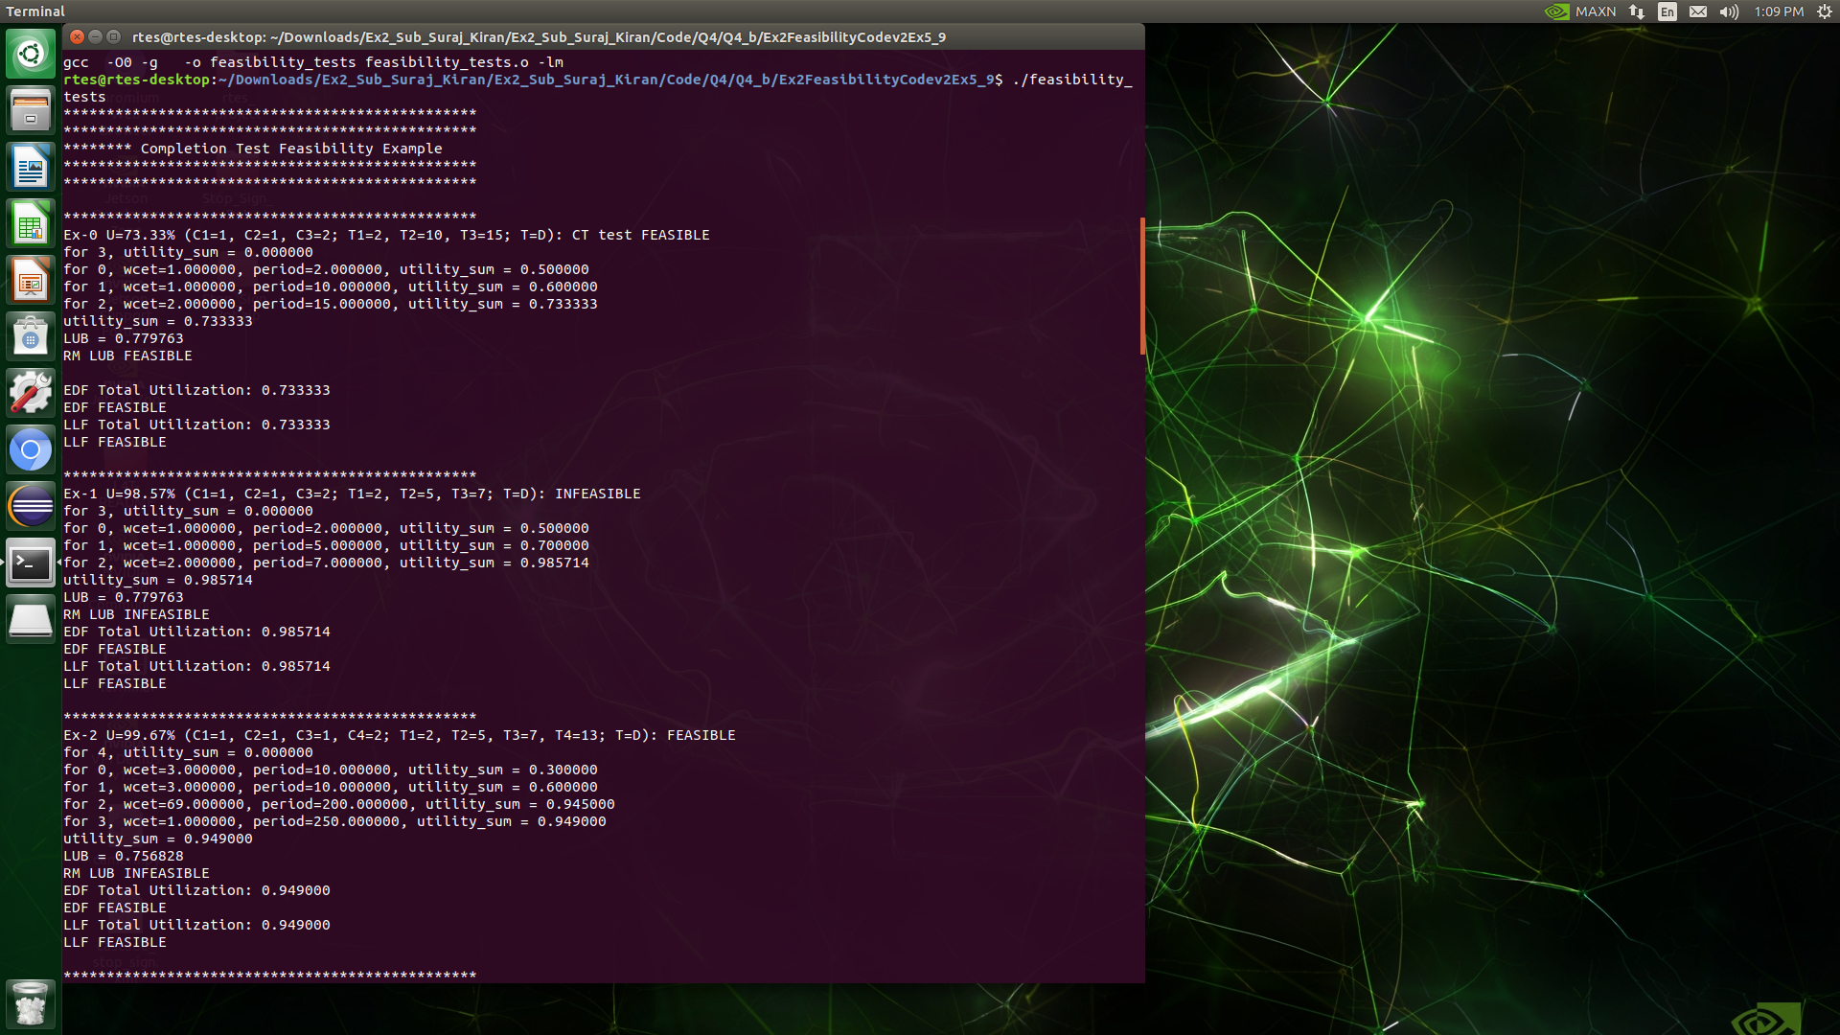
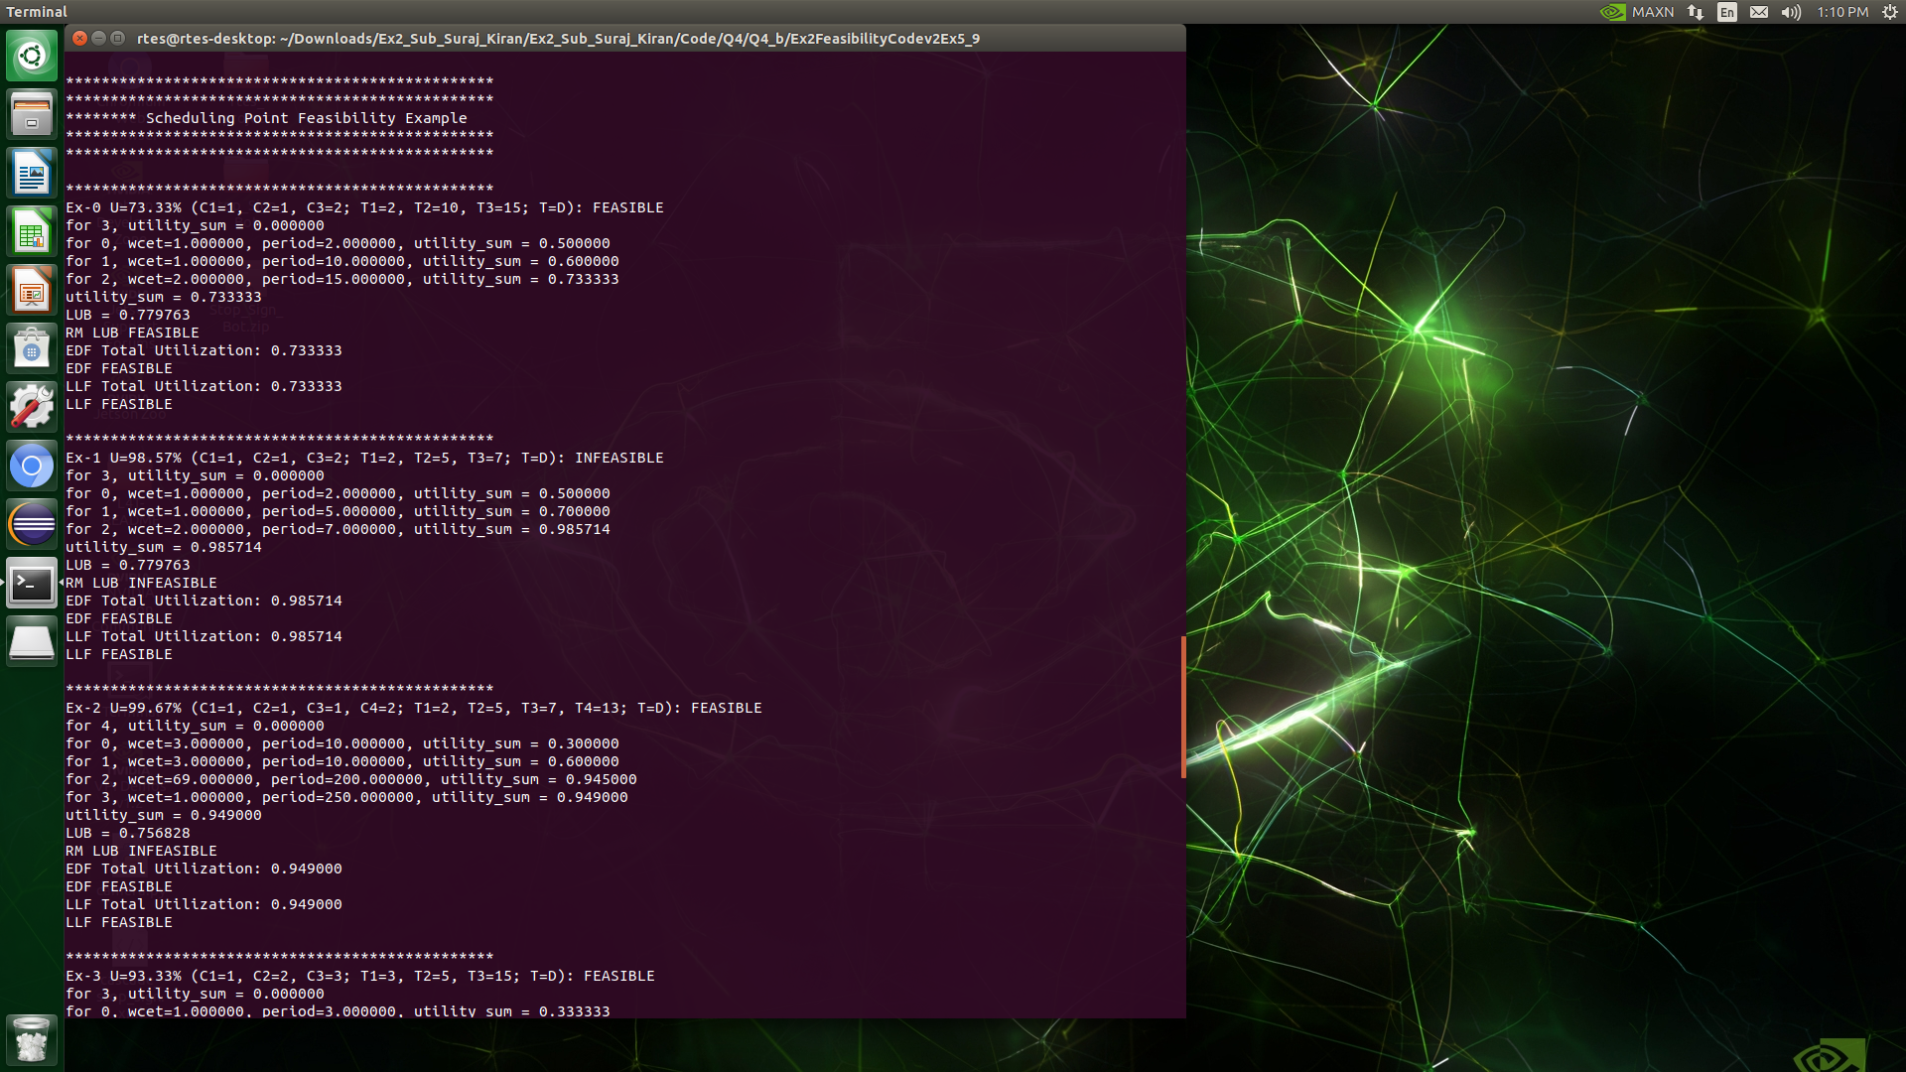
Scheduling Point and Completion Time Test

Slide 12
System Response Timeline
Input Latency
S1 Execution
Context Switch
S4 Execution
Context Switch
S2 Execution
Context Switch
S3 execution
O/p Latency
Deadline : 500 msec
Event Sensed
Actuation
200 msec
10 msec
10 msec
250 msec

Slide 13
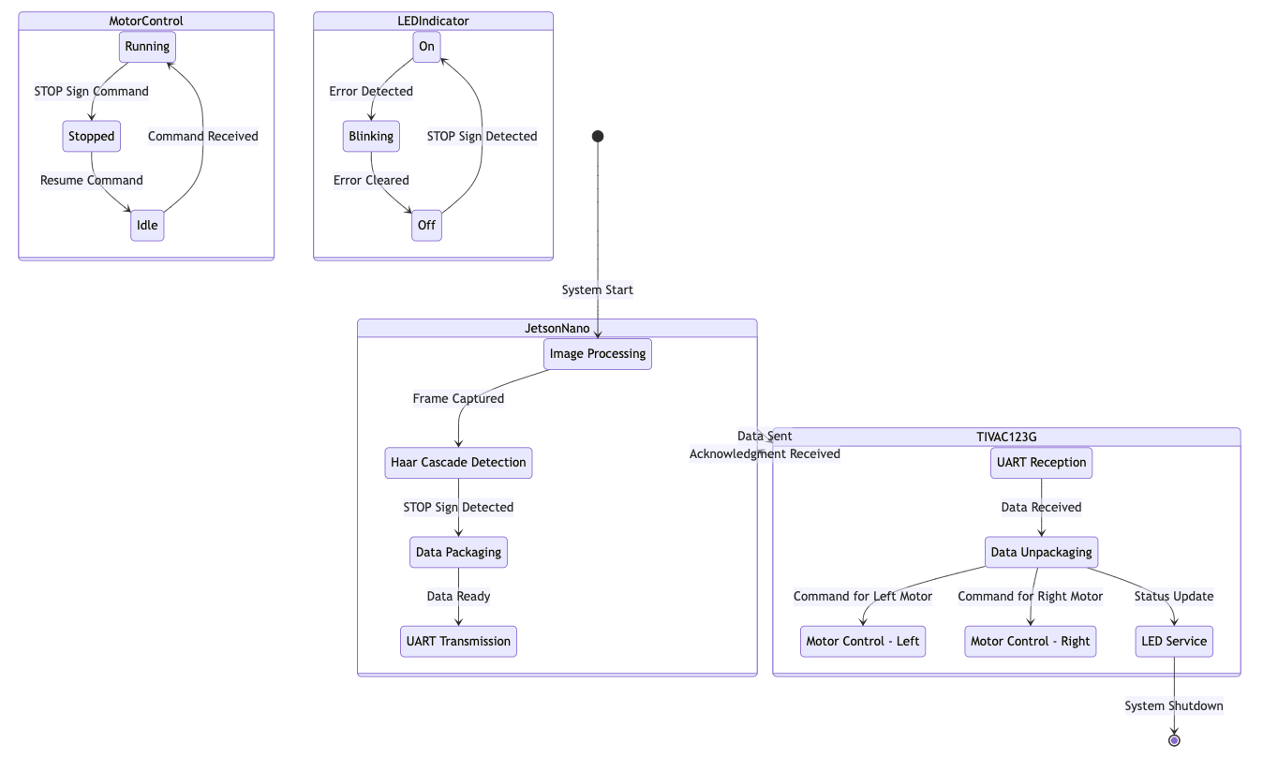

SA/SD State Machine DESIGN

Slide 14
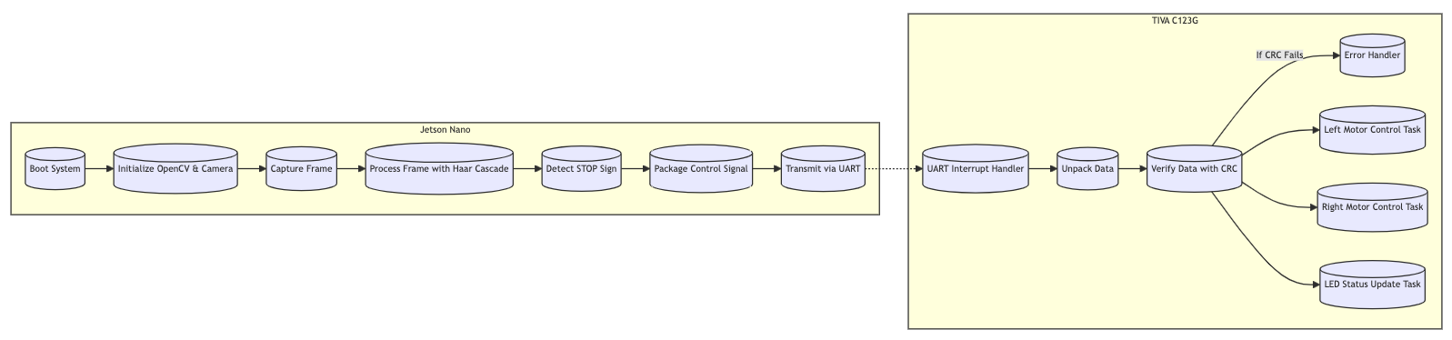
Control Flow Diagram(CFD)

Slide 15
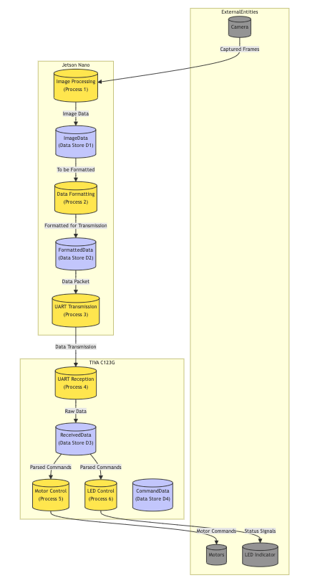
Data Flow Diagram

Slide 16
Proof-of-Concept Analysis
Platform Resources
Jetson Nano – Linux OS, Open CV4
TIVA C123GX –freeRTOS Kernel
L293D Motor driver
Key Prototype Implementation :
Camera service in Jetson Nano using openCV4 with Haar cascade classifier
UART Communication between Jetson Nano and TIVA
Motor Driver Firmware using PWM over TIVA
Sequencer Implemented using Timer Interrupt
Semaphores for synchronization between services and data shared between UART interrupt and services.

Slide 17
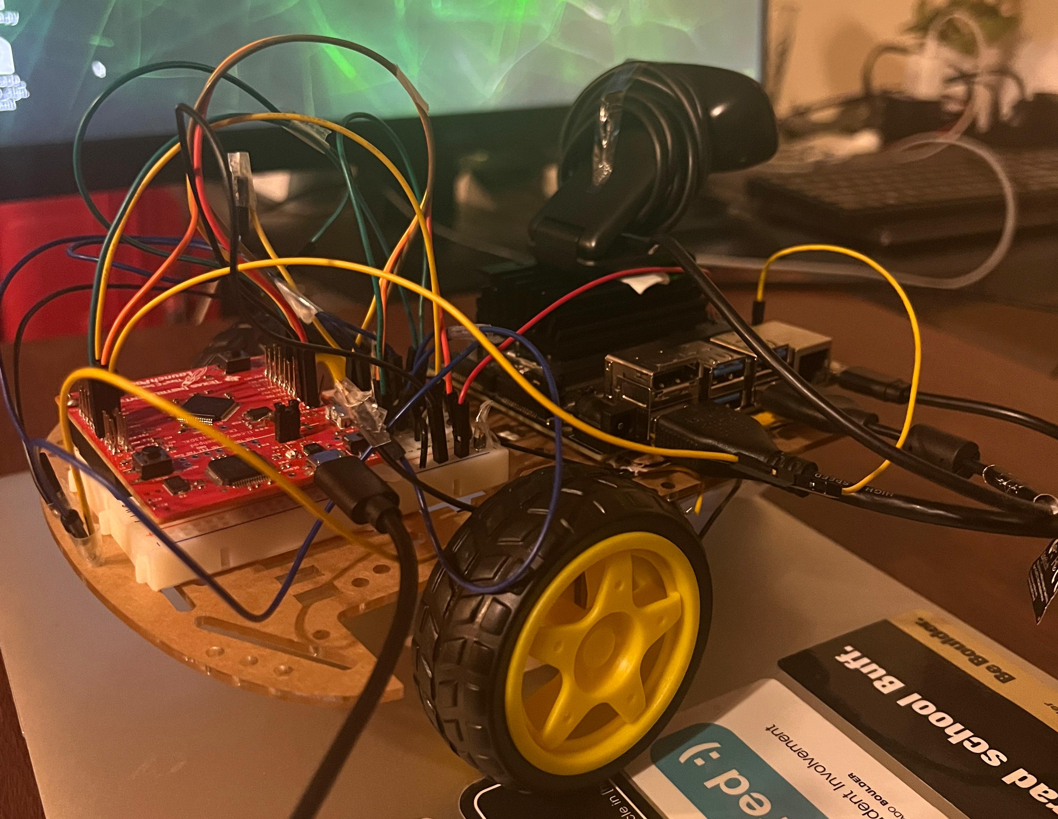
Hardware Prototype

Slide 18
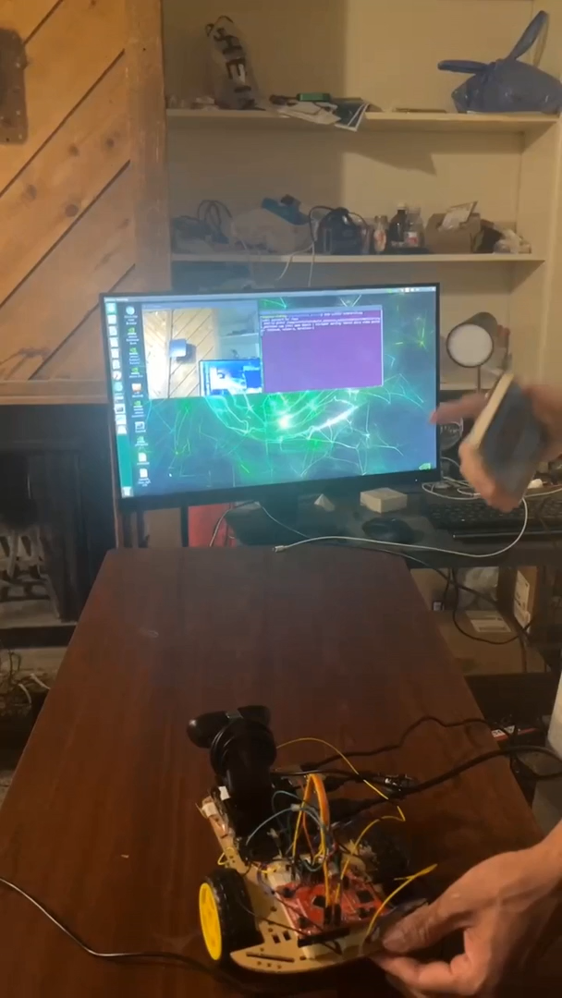
Proof of Concept Demo

Slide 19
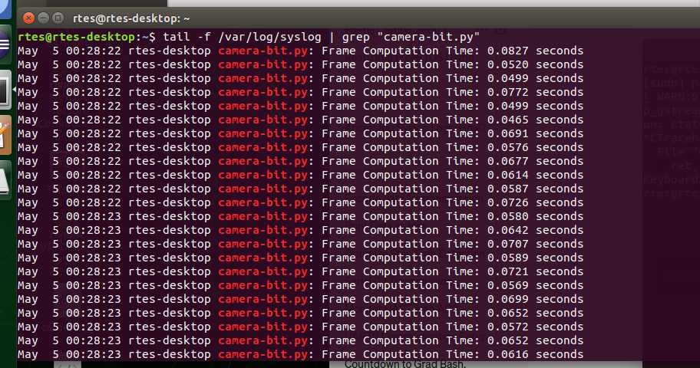
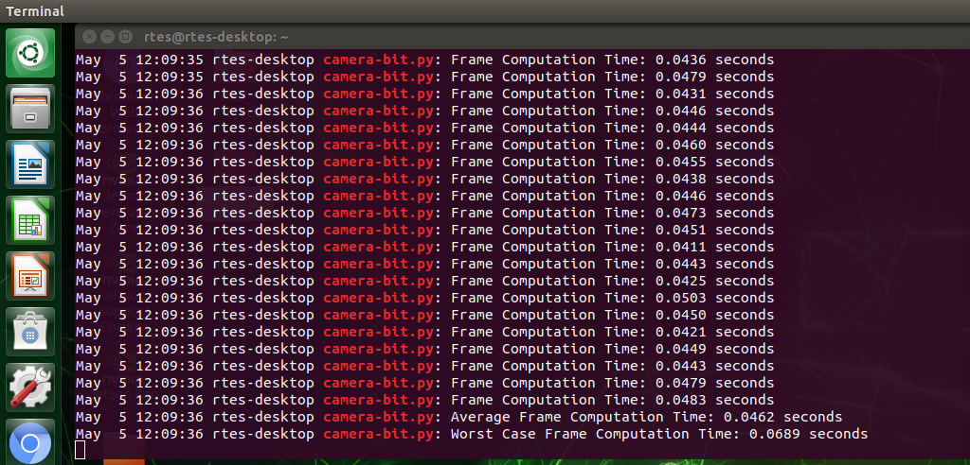
Time-stamp Tracing of Key Services
Time stamps of camera service in Jetson Nano

Slide 20
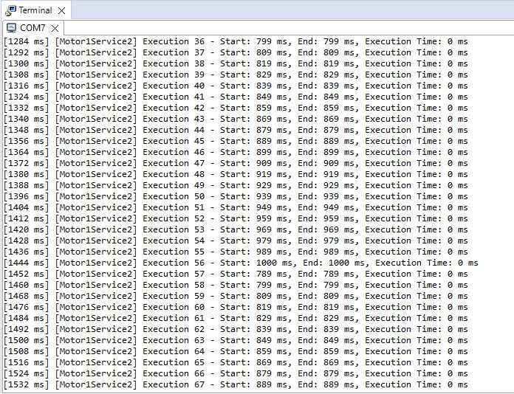
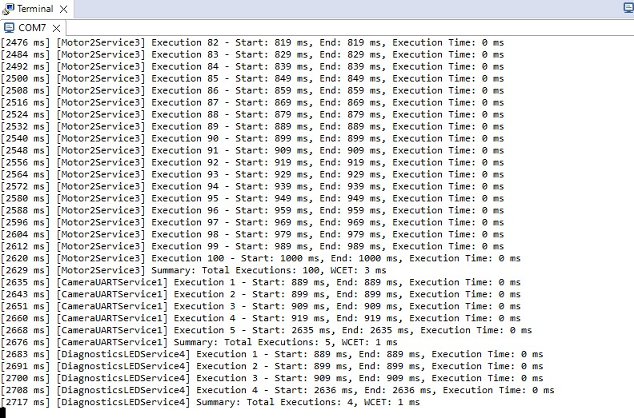
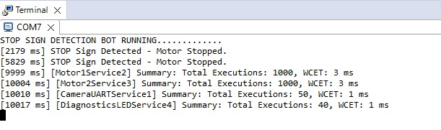
Time-stamp Tracing of Key Services Contd..
Start and stop timestamps for services on TIVA C123G
WCET values from time stamp In TIVA C123G

Slide 21



Verification & Validation Plans
Defined functional requirements including stop sign detection using OpenCV on Jetson Nano and motor control via UART communication with TIVA123.
Conducted final testing to ensure the system meets the initial project requirements and functions correctly under intended operating conditions.
Requirements Modelling
Acceptance Testing
Designed the system architecture to integrate two microcontrollers (TIVA123 and Jetson Nano)
Architectural Design
System Testing
Evaluated the entire system's performance, focusing on real-time task scheduling adherence and response accuracy to stop sign detection.
Detailed component specifications for the software modules handling UART data reception, motor control logic, and onboard LED diagnostics.
Component Design
Integration testing
Tested the integration of all modules to verify data flow from the Jetson Nano to TIVA123 and the correct motor responses based on the received commands.
Developed the code for each component in C, ensuring compatibility with the RTOS environment on TIVA123 and OpenCV on Jetson Nano
Code Gen
Unit Testing
Performed isolated tests for individual modules such as UART communication, motor control functions, and LED diagnostics to ensure functional integrity
Executable software
Software Engineering: A Practitioner’s Approach, 8/e (McGraw-Hill, 2014) copyright 2014 by Roger Pressman

Slide 22
Summary
Developed a cohesive system combining Jetson for image processing and TIVA for motor control, utilizing FreeRTOS for task management.
Achieved precise real-time detection and control, highlighting the critical role of service deadlines in real-time systems.
Integrated the camera module with the Jetson and established UART communication with TIVA. Implemented motor control using an L293D motor driver, ensuring the functionality sequence was maintained
Scheduled and executed all services within the defined timelines, effectively meeting all system deadlines.
Enhanced understanding of embedded systems and real-time applications, with significant challenges overcome in system integration and UART communication stability.

Slide 23
Thank You Prof Tim Nilesh, Viraj and Rishi Fellow classmates
Questions?

